Slide 1

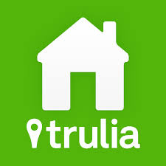
Scrapping Trulia
Samriddhi Shakya

Slide 2
About Trulia
Online residential real estate site for home buyers, sellers, renters and real estate professionals
It lists properties for sale and rent as well as tools and information needed to be successful in the home search process.
On July 28, 2014, Zillow announced a deal to buy Trulia for $3.5 billion.^{[3]}

Slide 3
Some Facts about Manhattan Rents
A “two-bedroom” isn’t always a two-bedroom
Be wary of these words—“duplex," “cozy” and “charming:“
Prepare to pay a broker’s fee:
Always negotiate:
Have all necessary documentation in order:

Slide 4
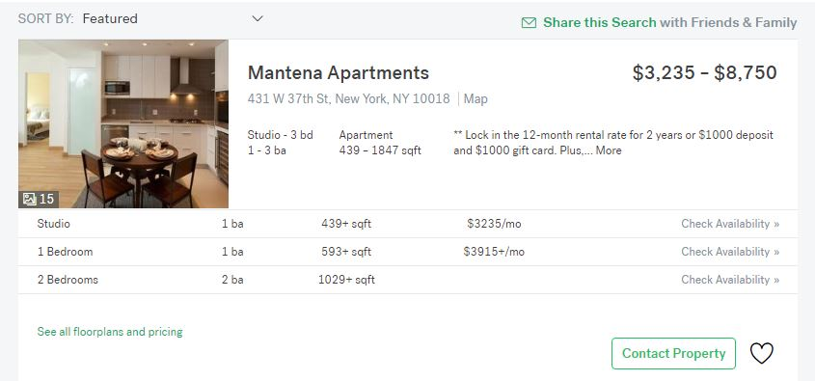
Scrapping Project
Apartment Community Complex - Total = 86
Studio Apartments
1 bed room Apartments
2 bedroom Apartments

Slide 5
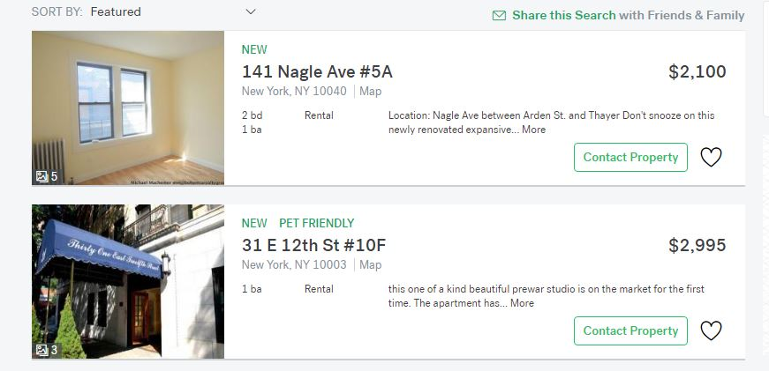
2. Individual Apartments/Condo/ Townhomes – Total = 6767
1-7 bedroom

Slide 6
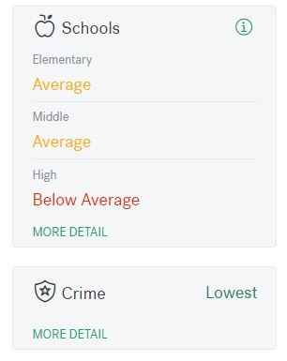
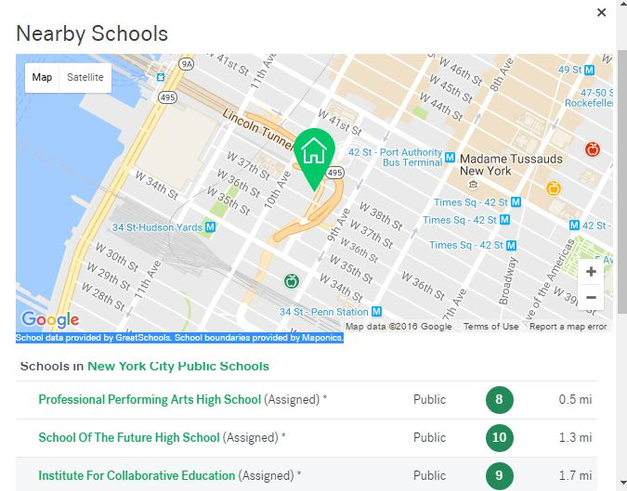
School Ratings

Slide 7
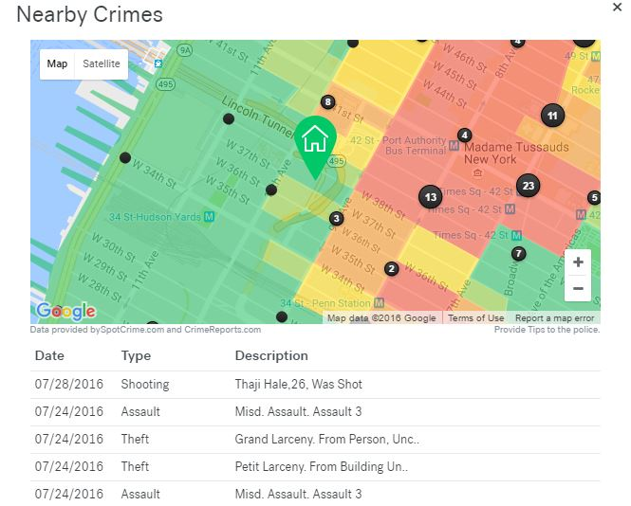
Crime Info

Slide 8
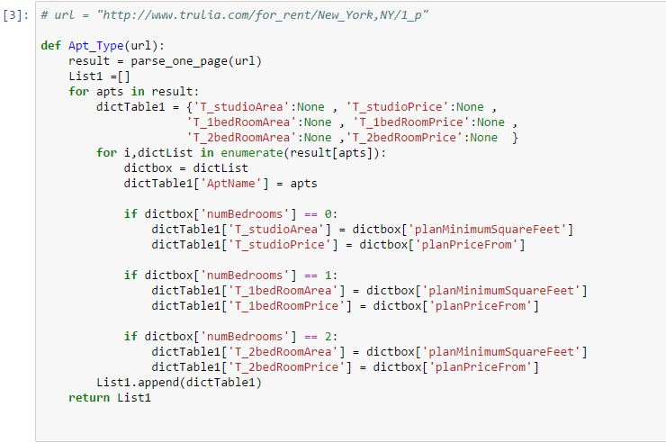

Slide 9
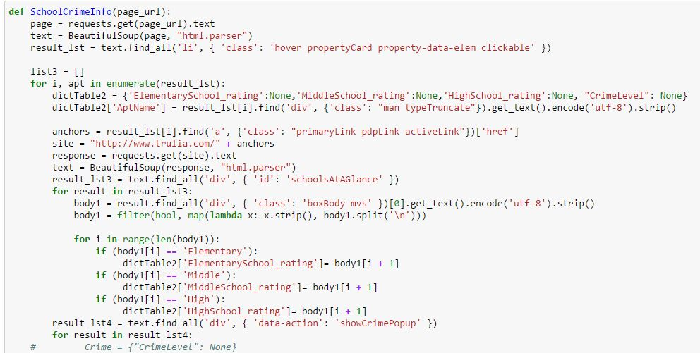

Slide 10
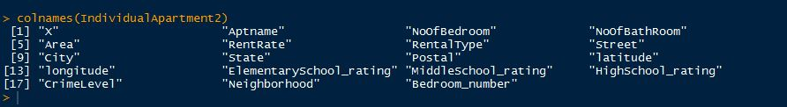
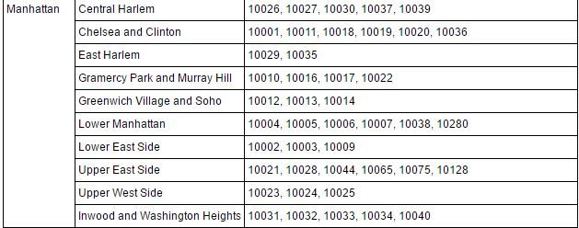

Slide 11
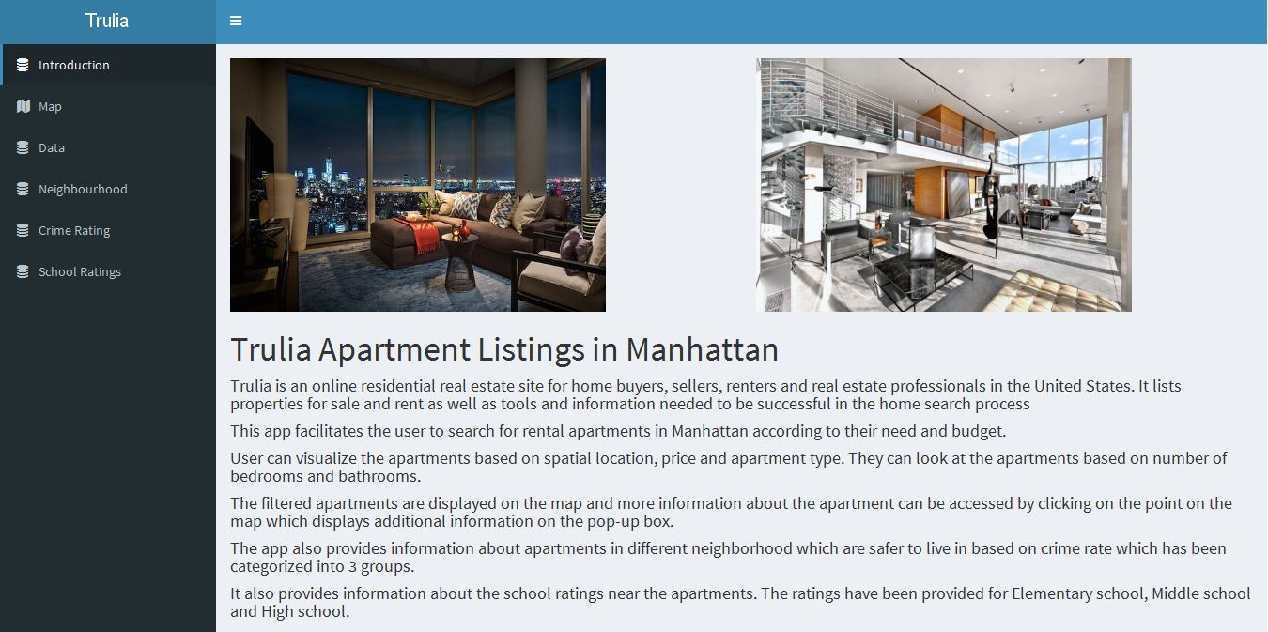

Slide 12
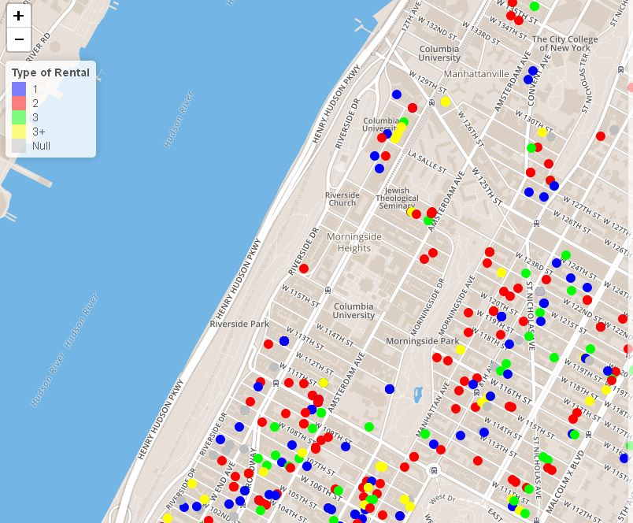

Slide 13
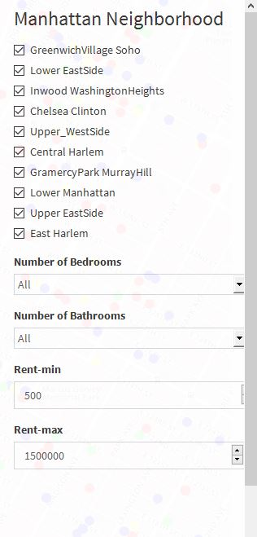
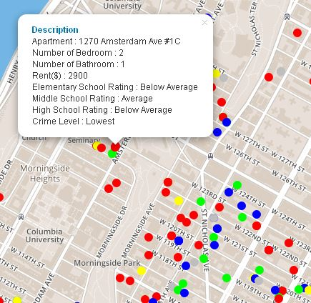

Slide 14
App Demonstration
https://samriddhishakya.shinyapps.io/Trulia/

Slide 15
Future Works
Expanding to other boroughs in New York
Include more data from the website
Add more Features to the map
Add Pictures of the Apartments
Built a multiple linear regression model to estimate price based on different predictor values.

Slide 16
Questions ?

